Slide 1
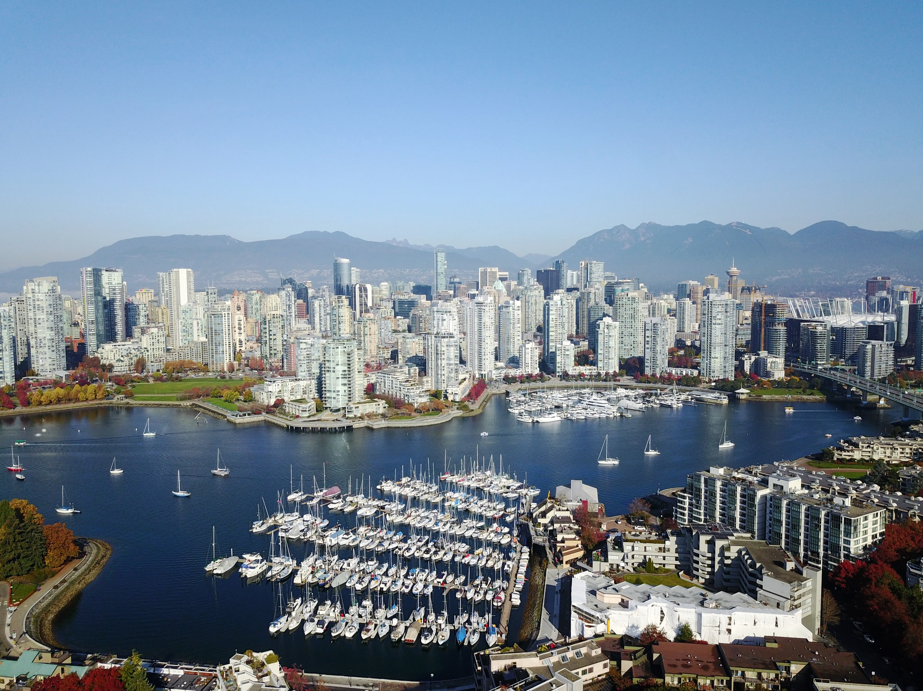
Dogs and Suds: Analysis of locations for a dog bar in Vancouver, BC
James R Cardwell
Aug 2021
Photo: Lee Robinson, Unsplash

Slide 2
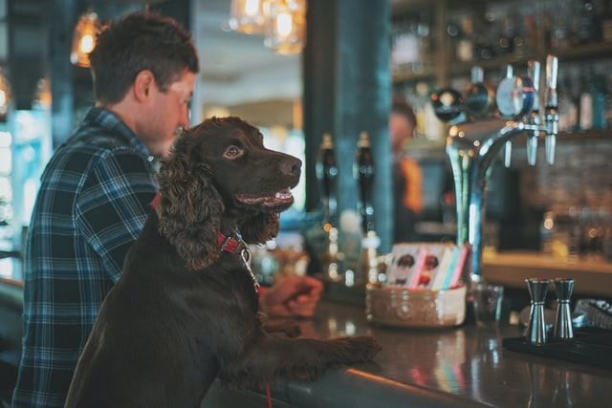
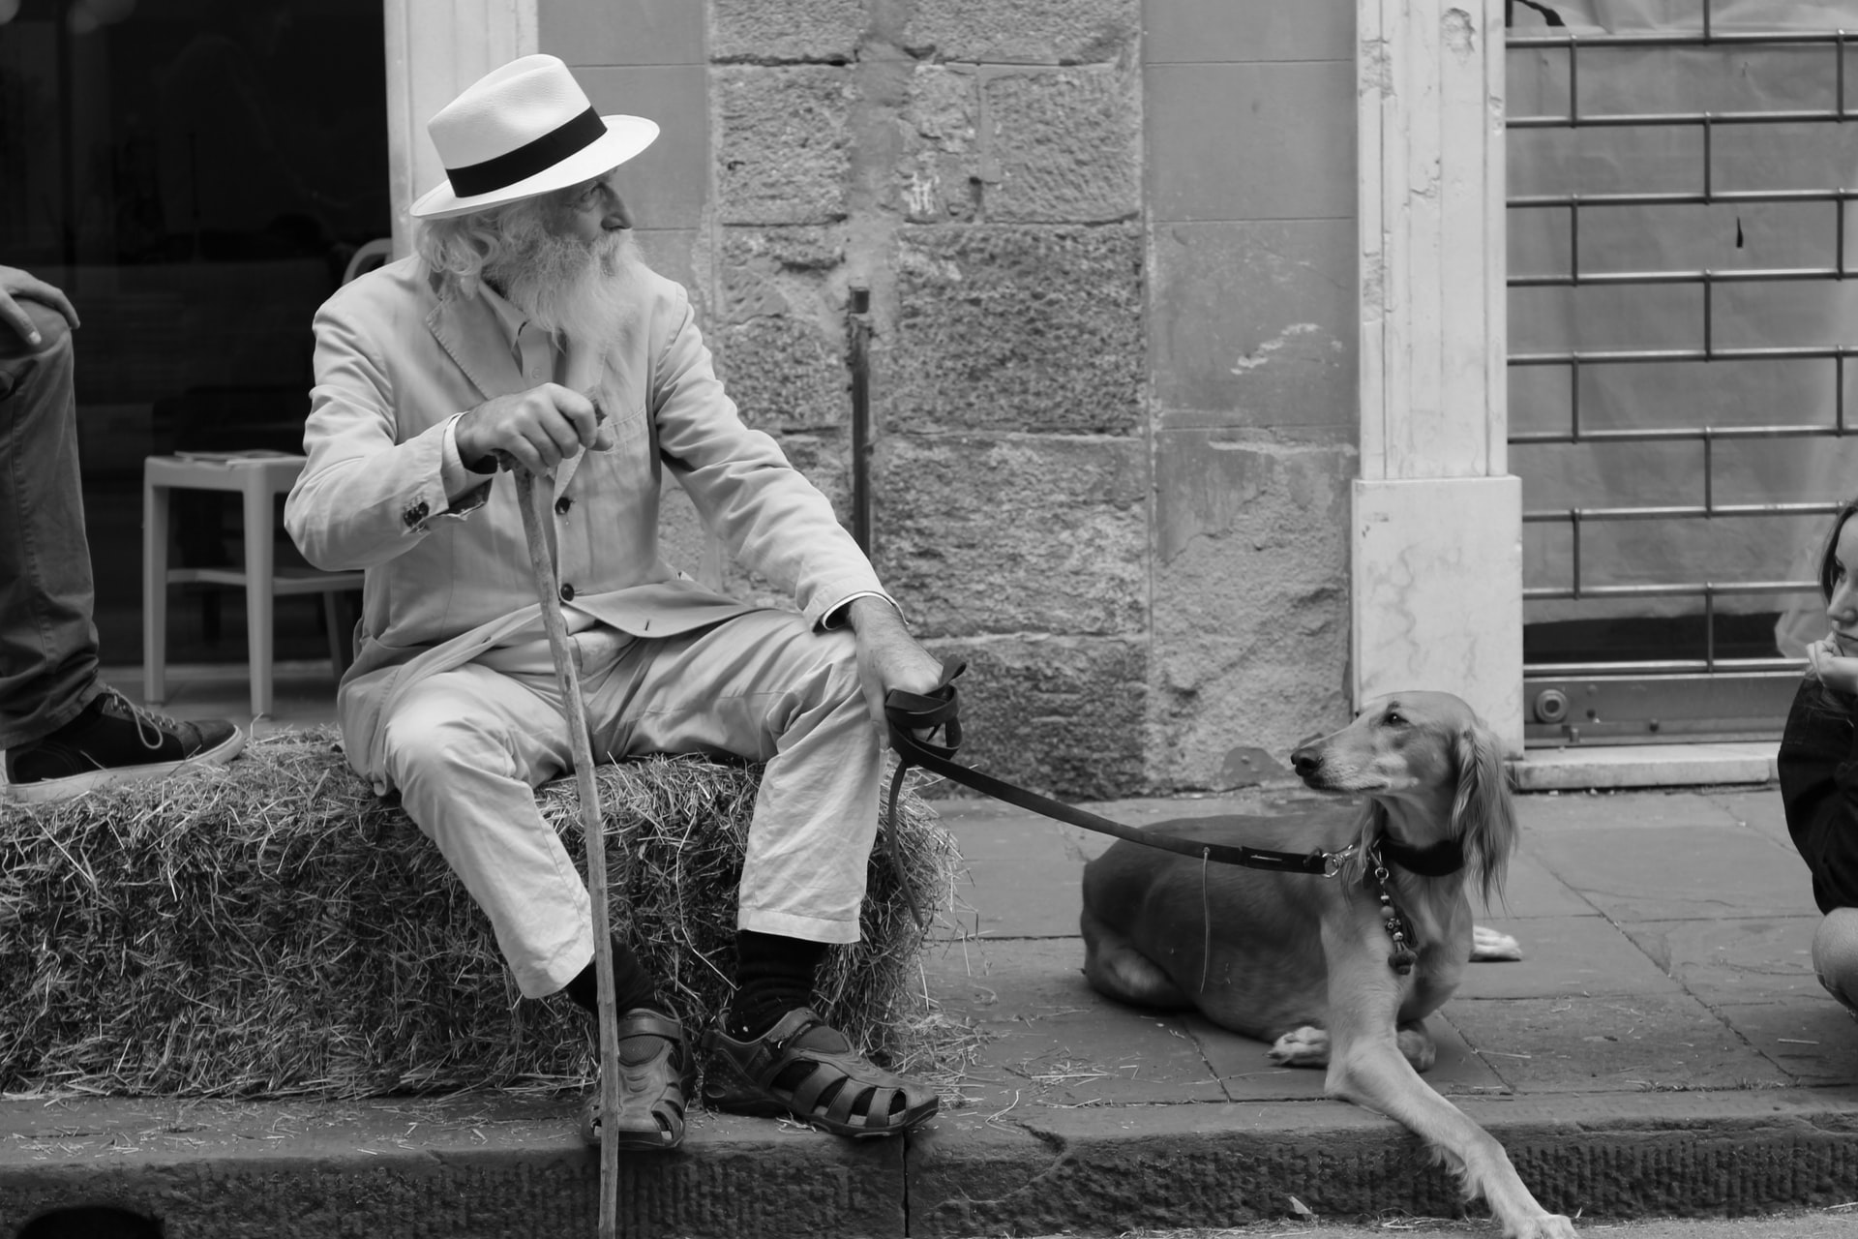
The human relationship with Man’s best friend is thousands of years old, and dogs have become a cherished part of our lives.
Photo: Mandy Henry, Unsplash

Slide 3
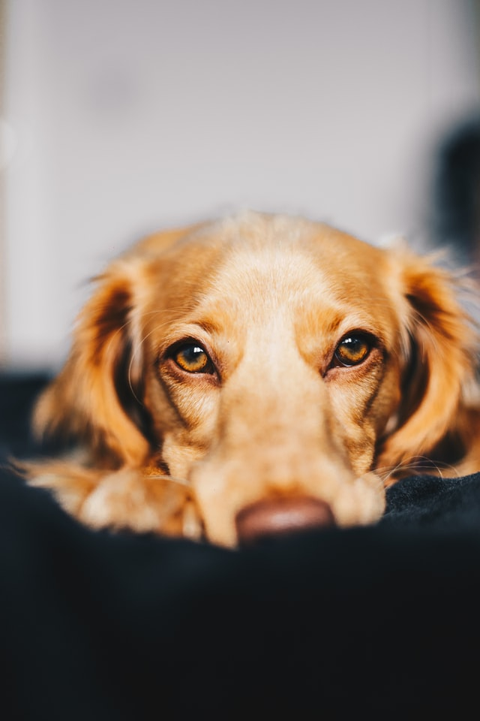
In Canada, 35% of households have a dog and this number is growing
Nurturing the human-dog bond is important, and this includes exercising, playing and being together as often as possible.
Photo: James Lacy, Unsplash

Slide 4
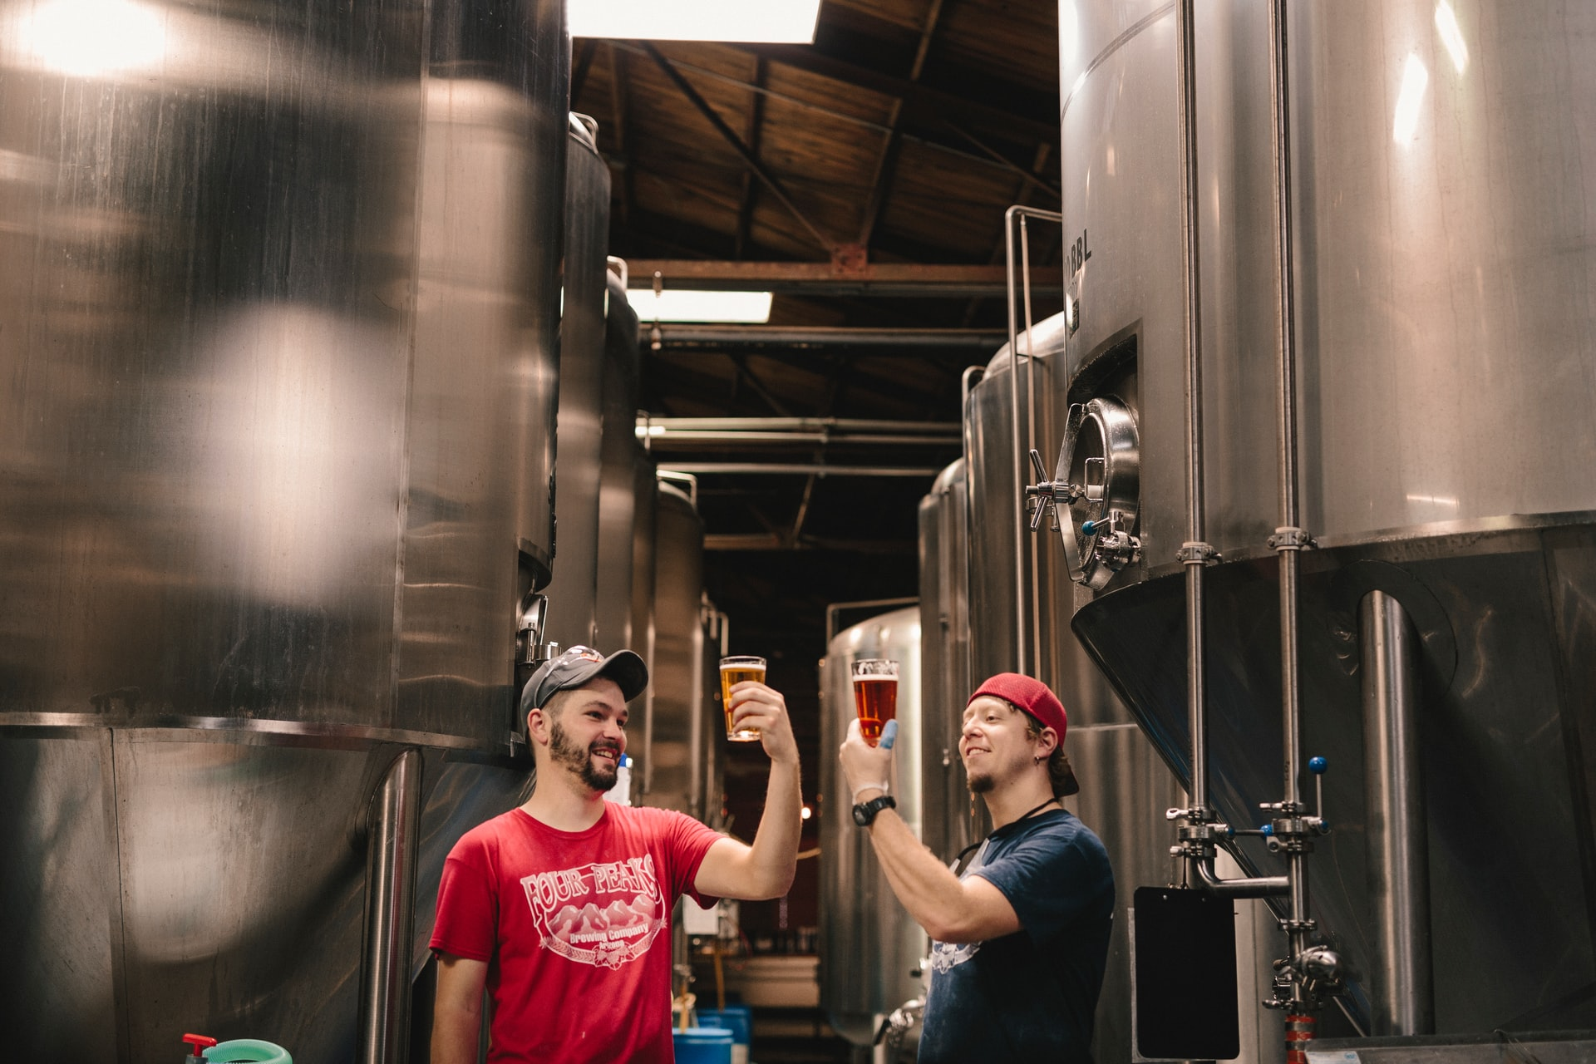
Vancouverites also love their beer:
British Columbia is also home to a growing number of craft breweries,
with over 20 new breweries added each year since 2011
This explosion of breweries supports an even larger number of neighborhood pubs and bars with over 300 in the City of Vancouver
Photo: Sigmund, Unsplash

Slide 5
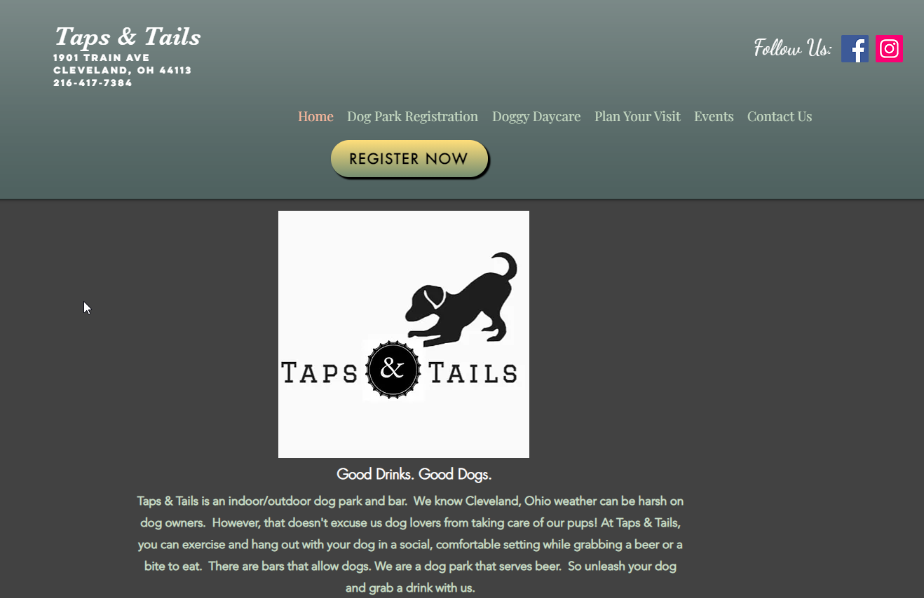
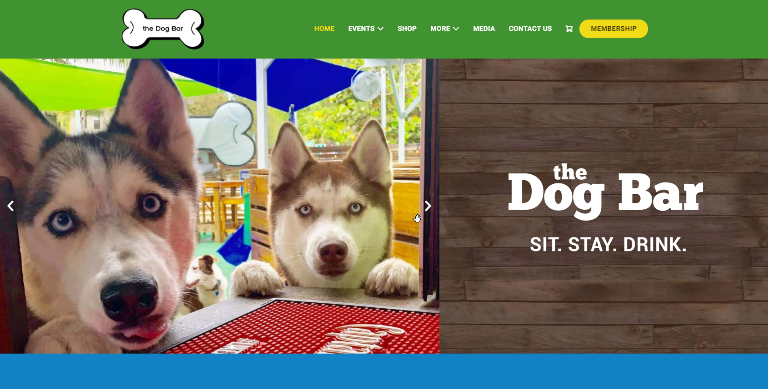
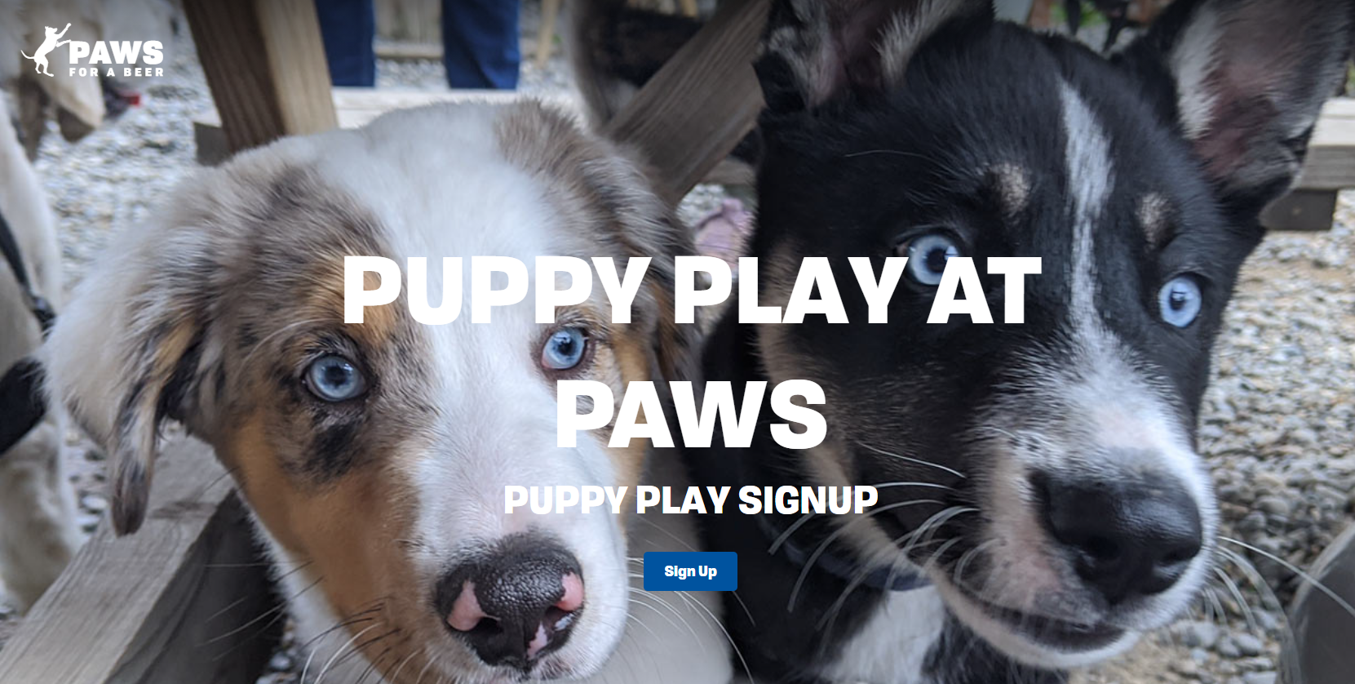
Best of both worlds? An off-leash beer garden – a dog bar!
Dog bars exist in the US,
but there are none in Vancouver

Slide 6
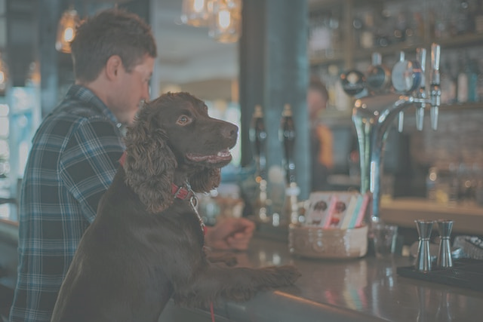
The Dogs and Suds dog bar would be Vancouver’s first dog bar where dog owners can exercise their pet while sipping their favorite beverage, enjoy the company of
like-minded dog owners and their dogs can exercise and socialize with other dogs.
Business Problem:
In which Vancouver neighborhood should the new dog bar be located?
Photo: James Lacy, Unsplash

Slide 7
Data Sources
1. Wikipedia.com
Description: list and descriptions of the 22 neighborhoods of the City of Vancouver, BC, Canada.
Purpose: to identify the neighborhoods in Vancouver
2. City of Vancouver Open Data Portal
Description: listing of Vancouver's 22 neighborhoods’ bounding polygons and centroids
Purpose: to obtain the boundary locations and central point of each neighborhood
3. People, Parks and Dogs Strategy Appendix
Description: PDF document containing a table from the Statistics Canada 2016 census data on dog-owning households in Vancouver Neighborhoods.
Purpose: to obtain data on the density of dog-owning households by neighborhood
4. Foursquare API
Description: An API that can be used by developers to query the Foursquare database of venues, their categories and other attributes.
Purpose: to identify and locate pubs and existing dog parks in Vancouver neighborhoods.

Slide 8
Rationale
The Dogs and Suds dog bar should be located in a neighborhood with a high number of dogs – such neighborhoods should have a high need for a new dog park.
The dog bar should be located in a neighborhood with a high number of pubs – pub owners in such neighborhoods have already assessed the demographics, transportation and other success factors and should have a high number of pub-goers that could also be drawn to the dog bar, especially if they are also dog owners.
The dog bar should be located in a neighborhood that is less well served by existing dog parks – the increased need for a dog park should drive customers to the Dogs and Suds dog bar.
Methodology
Obtain data for the names, centroids and boundaries for Vancouver neighborhoods (Data Sources 1 and 2)
Obtain a dataset containing the licensed dogs in each neighborhood (Data source 3)
Obtain a dataset containing existing dog parks in Vancouver (Data source 4)
Obtain a dataset containing existing pubs in Vancouver (Data source 4)
Perform exploratory data analysis to better understand the data
Perform K-Means Clustering to identify clusters of neighborhoods that will be candidates for the dog bar location
Visualize the clusters and characterise the neighborhoods in each cluster to select the final candidates

Slide 9
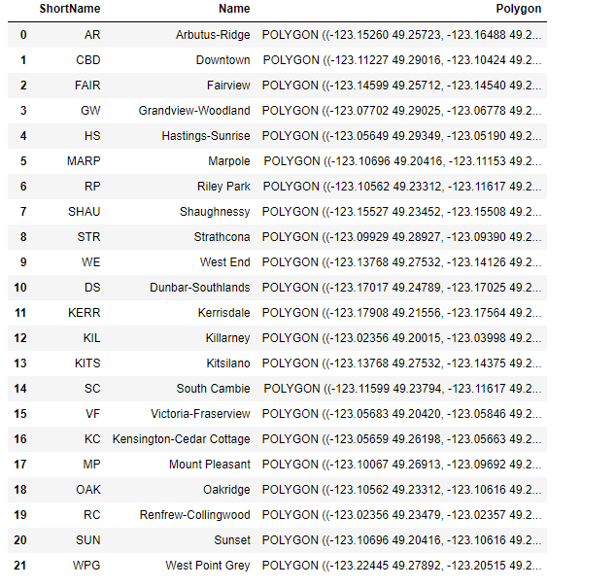
Results and Discussion
We obtained central points and polygons for the 22 official Neighborhoods in Vancouver

Slide 10
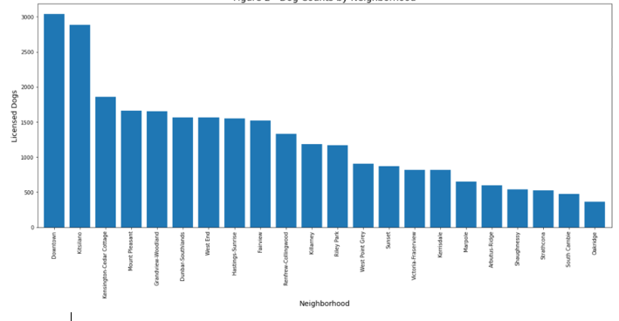
Licensed Dogs by Neighborhood
The Downtown and Kitsilano neighborhoods, followed by Kensington-Cedar Cottage have the most dogs, whereas Oakridge, South Cambie, Strathcona and Shaughnessy have the least.

Slide 11
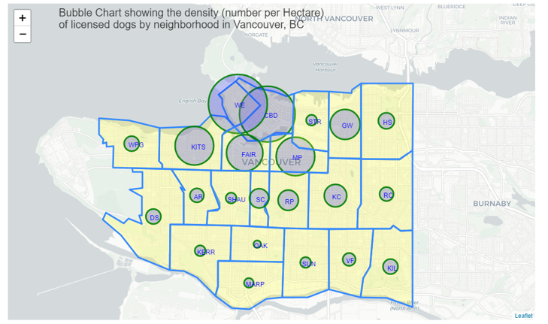
Dog density by Neighborhood
The bubble chart shows that density of dogs (dogs/hectare) varies significantly across neighborhoods with the highest densities being in West End, Downtown, Kitsilano, Fairview, Mount Pleasant and Grandview-Woodlands neighborhoods.

Slide 12
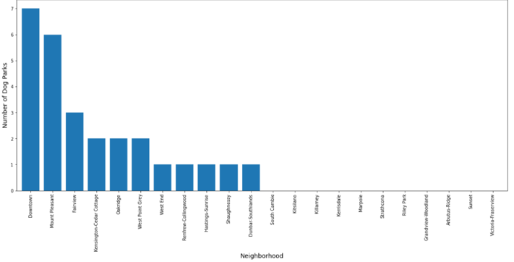
Dog Parks by Neighborhood
The Downtown neighborhood has the most dog parks followed by Mount Pleasant, Fairview and Kensington-Cedar Cottage.

Slide 13
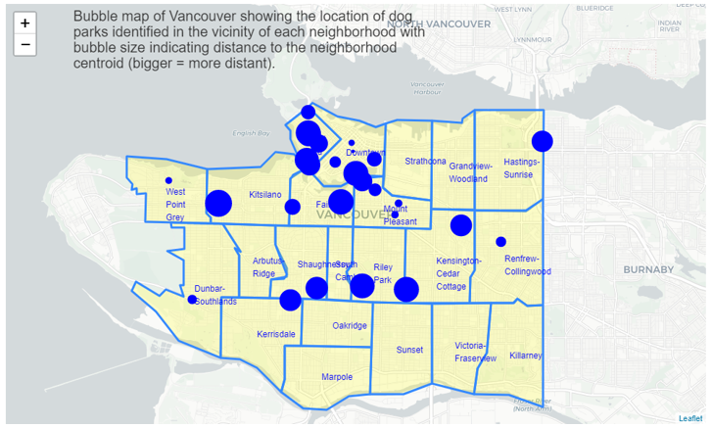
Dog Park locations
Several neighborhoods are poorly served by dog parks, having none within 1.5 km of the central point, including Kitsilano which had the second highest number of dogs.

Slide 14
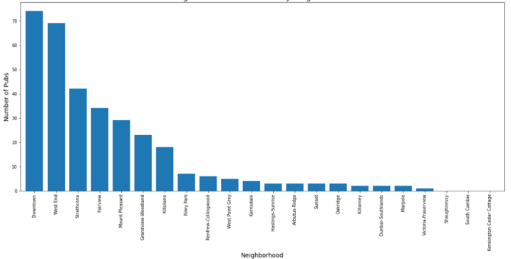
Pubs by Neighborhood
The data set contained 330 pubs, ranging from none to 74 pubs per neighborhood! The median was 3.5 pubs.
Downtown, West End, Strathcona, Fairview, Mount Pleasant, Grandview-Woodland and Kitsilano had higher numbers of pubs than the rest.

Slide 15
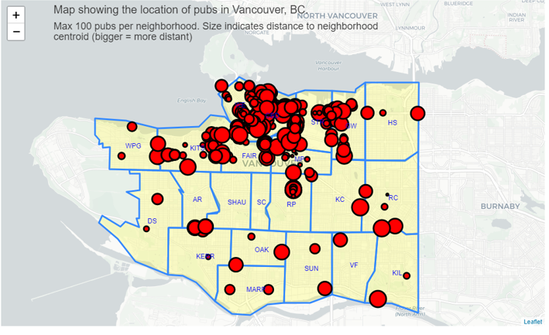
Pub locations
Pubs are more frequently found in the northern 1/3 of the city compared with the central and southern neighborhoods.
Pub-going dog owners would be more likely to be found in those areas as well.

Slide 16
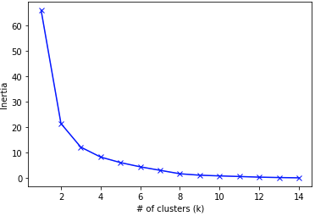
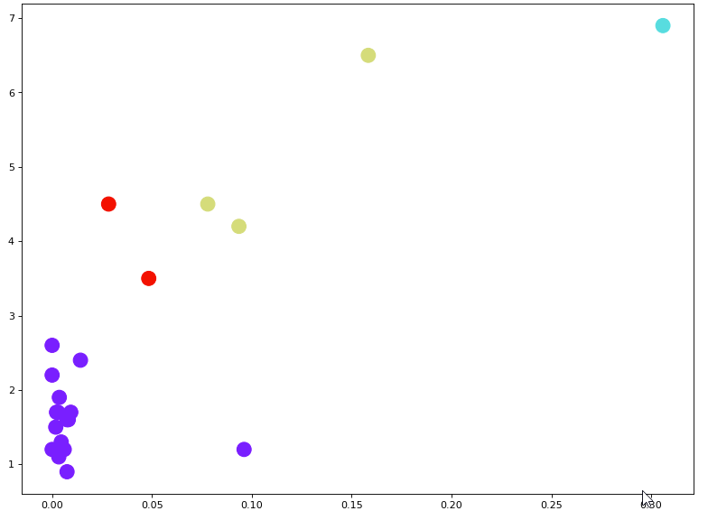
K-Means Clustering
Using normalized data on dog density, pub density and dog park density, we modelled 15 values of ‘K’ (the number of clusters), and evaluated the optimum value using the Elbow Method (plotting inertia against the # of clusters) tested)
The Elbow Method indicated that the optimal number of clusters is 4
A scatter plot of the 22 neighborhoods in which the point’s color corresponds to the cluster number showed four clearly distinguishable clusters in the data

Slide 17
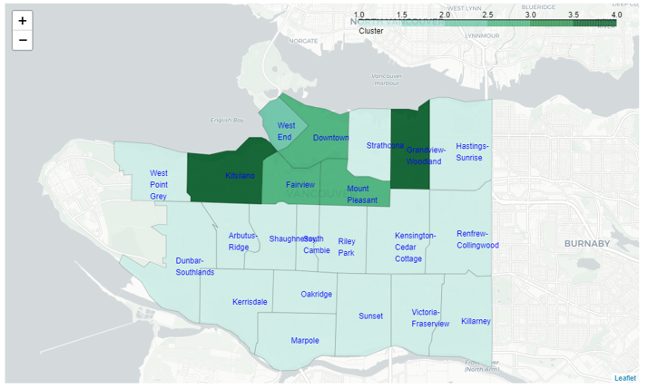
Visualizing the cluster locations
A choropleth map was used to visualize the four clusters.
One cluster accounted for 16 of the 22 neighborhoods.
There was a tendency for the remaining clusters to be located in the north-central section of the city

Slide 18
Characterizing the clusters
The first cluster accounted for 16 neighborhoods and had low dog density, low pub density and low dog park density. These neighborhoods are not good candidate locations for the dog bar
The second cluster had a single neighborhood with high dog density, high pub density and moderate dog park density. This neighborhood might be a worthwhile candidate, but it is already fairly well served by dog parks.
The third cluster had 3 neighborhoods with moderate dog density, moderate pub density but high dog park density. Again, these neighborhoods may be good candidates, but the high dog park density makes them less than ideal.
The final cluster with 2 neighborhoods (Grandview-Woodlands and Kitsilano) had moderate dog density, moderate pub density but are poorly served by existing dog parks with a median dog park density of 0. These two neighborhoods would be the best candidates in which to locate the dog bar.
Cluster | Count | Dogs/Ha (median) | Pubs/Ha (median) | Dog Parks/Ha (median) | Recommendation
1 | 16 | 1.6 (low) | 0.004 (low) | 0 (low) | Poor candidates
2 | 1 | 6.9 (high) | 0.306 (high) | 0.004 (med) | Moderate candidates
3 | 3 | 4.0 (med) | 0.094 (med) | 0.015 (high) | Moderate candidates
4 | 2 | 4.0 (med) | 0.043 (med) | 0 (low) | Good candidates

Slide 19
Discussion
Assumptions:
We made a few assumptions in conducting this study, and they may or may not be significant.
For example, we assumed that dog license count reflects the actual number of dogs in each neighborhood. In reality, some neighborhoods with lower income levels may not license their dogs for economic reasons and this would skew the numbers.
The dog population data was from 2017 and may be somewhat out of date. However, the impact of using older data should be similar across neighborhoods.
The recent COVID-19 pandemic may have resulted in pubs being closed but not removed from the FourSquare dataset. Again, this should have impacted all neighborhoods the same way.
We may have underestimated the number of dog parks due to the key words we used to filter the FourSquare API data. This too should have impacted all neighborhoods the same way.

Slide 20
Discussion cont’d
Refinements and future studies:
There are several opportunities to refine this analysis – some other features could be:
Socio-economic status, age and cultural mix of the neighborhoods
Analysis of the relative dog-friendliness of existing pubs
More fine-grained analysis of the data by avenue/street/block to identify specific addresses
Finally, location is only one in a large number of factors that will influence the establishment of the Dogs and Suds dog bar. Future studies may need to focus on economic feasibility, the cost of property across neighborhoods, licensing and other factors.

Slide 21
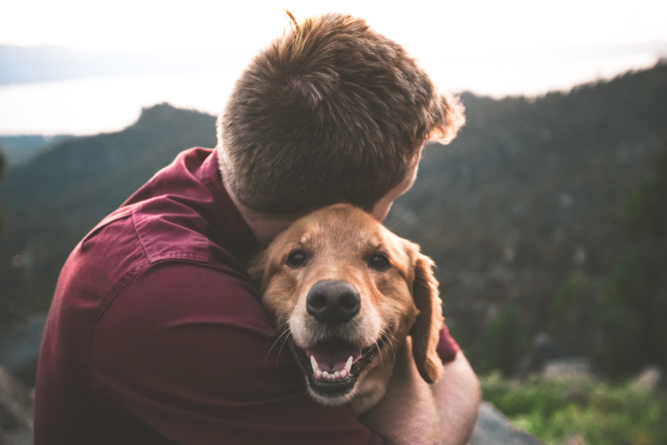
Conclusion
Dog owners love their pets and need to take them out for exercise and socialization.
Dog bars allow them to do so while consuming their favorite beverage in a dog-friendly environment, and in doing so enjoy social interaction with like-minded pub-going dog owners.
In this study we analyzed data from several sources to identify a cluster containing two neighborhood candidate locations for a dog bar.
We conclude that the neighborhoods of Grandview-Woodlands and Kitsilano provide the best mix of a dog-owning population, existing pubs to attract visitors and that are poorly served by existing dog parks and are therefore the best candidate neighborhoods in which to locate Dogs and Suds, Vancouver’s first dog bar.
Thank you!
Photo: Eric Ward, Unsplash

Slide 22
References
Serpell, J. (1995). The Domestic Dog: Its Evolution, Behaviour and Interactions with People. Retrieved from: https://books.google.com.au/books?id=I8HU_3ycrrEC&lpg=PA7&dq=Origins%20of%20the%20dog%3A%20domestication%20and%20early%20history%20%2F%E2%80%8B%20Juliet%20Clutton-Brock&pg=PA7#v=onepage&q&f=false
Podberscek,Anthony L., Paul, Elizabeth S. and Serpell, James A.(2005) Companion Animals and Us: Exploring the Relationship Between People and Pets. Cabridge University Press
Bush (2011). Canada's Pet Wellness Report. Retrieved from: https://www.canadianveterinarians.net/documents/canada-s-pet-wellness-report2011#:~:text=The%20subject%20of%20pet%20wellness,(source%3A%20Ipsos%20Reid
Chapman, M and Pisani, S. (2020) https://narrativeResearch.ca/canada-has-seen-a-significant-increase-in-pet-owners-since-the-start-of-the-covid-19-pandemic/
Siren, C (2021) https://www.cahi-icsa.ca/news/2020-canadian-pet-population-figures-released
Wiebe, J, 2020. Looking Back on the Biggest Decade in BC Craft Beer History https://bcaletrail.ca/looking-back-on-the-biggest-decade-in-bc-craft-beer-history/
Wikipedia (2021) List of Neighborhoods in Vancouver. https://en.wikipedia.org/wiki/List_of_neighbourhoods_in_Vancouver#Official_neighbourhoods retrieved July 2021
City of Vancouver (2016) https://opendata.vancouver.ca/explore/dataset/census-local-area-profiles-2016/information/
Vancouver Park Board (2017) People Parks & Dogs: A strategy for sharing Vancouver's parks: https://vancouver.ca/files/cov/people-parks-dogs-strategy-report.pdf and the appendix: https://vancouver.ca/files/cov/people-parks-dogs-strategy-appendix.pdf

